Slide 1
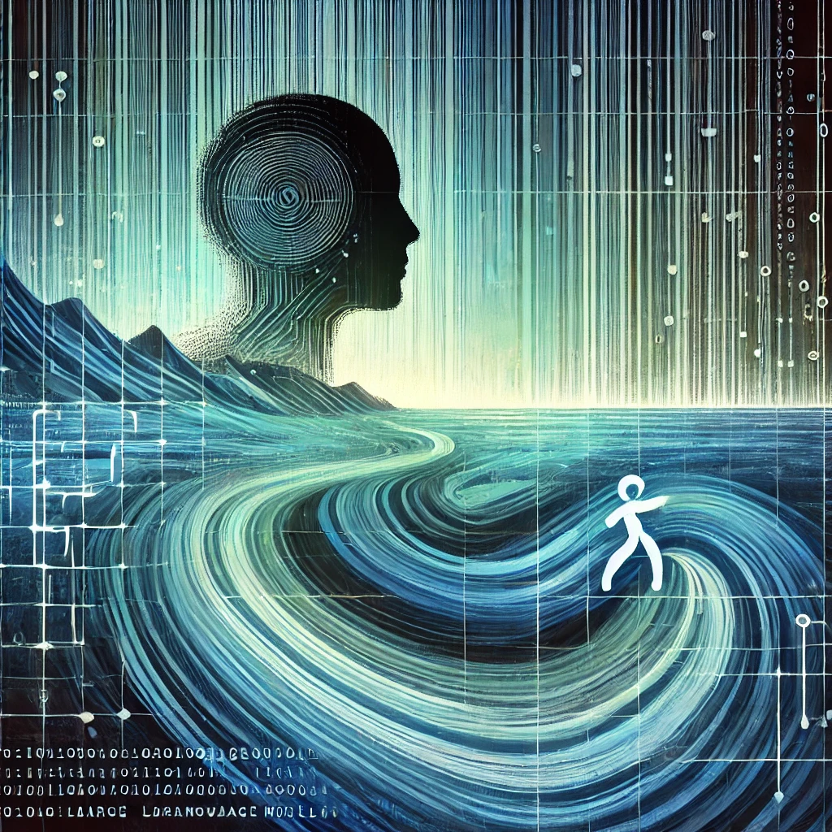
How to Make AI Output Detectable?
Scott Aaronson (UT Austin)
AI, Systems, and Society Conference
Emory University, Atlanta, GA, March 7, 2025

Slide 2
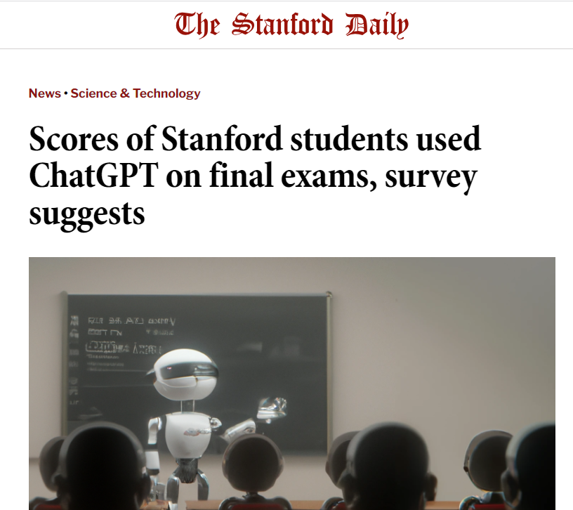
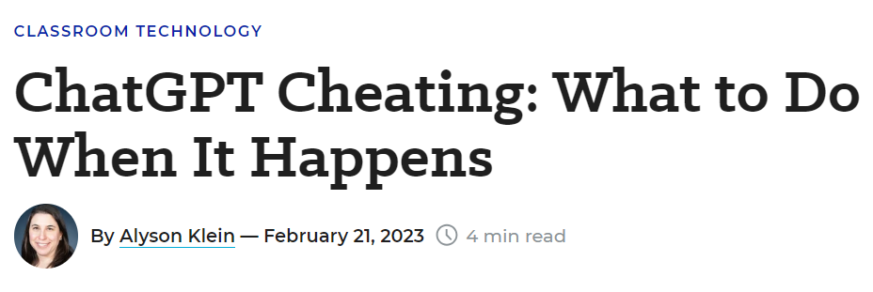
The Attribution Problem
Insight: Almost any nefarious near-term use of Large Language Models that you can think of (cheating, propaganda, fraud, spam…) involves concealing the LLM’s involvement. If only we could make that harder!

Slide 3
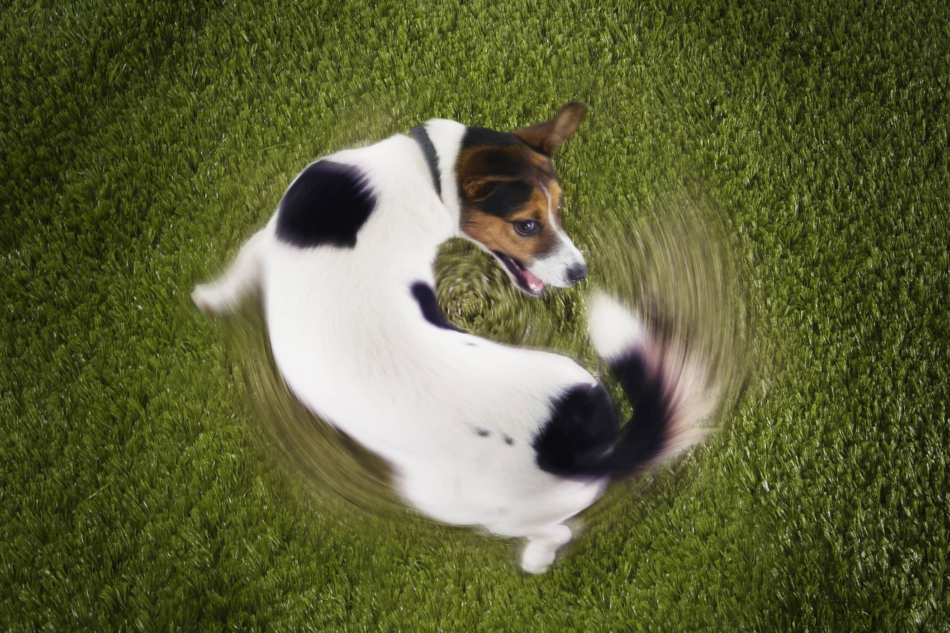
Another reason to care about attribution
As the Internet gets filled with LLM-generated text, we’ll often need to prevent that text from getting fed back in as training data… which requires recognizing it

Slide 4
Proposed Solutions
Just look for formulaic prose, or “As a large language model…” ☺
Metadata ← trivial to remove from text!
Giant database of completions ← privacy?
Discriminator models, like GPTZero or DetectGPT or Ghostbuster ← too many false positives?
Watermarking: inserting a statistical signal into the LLM’s choice of tokens

Slide 5
LLM Watermarking
Idea: Add a hidden statistical signal to LLM outputs, to make it easier to prove that they came from an LLM
Exploits the fact that most LLM generation is already probabilistic
I started advocating this in Summer 2022, shortly after joining OpenAI’s Alignment team. Many others, at UMD, Berkeley, Stanford, DeepMind, etc. since took the idea much further

Slide 6
My “Gumbel Softmax” Scheme
At position $t$, let $p_{t,i}$ be the probability of the $ith$ possible token output by the model; let $r_{t,i}∈\left[0,1\right]$ be a pseudorandom function of the previous $k$ tokens
At each position $t$, choose the token $i=i(t)$ that maximizes $r_{t,i}^{1/p_{t,i}}$
In detection phase: Calculate $\sum_{t=1}^{n}{\ln{\frac{1}{1−r_{t,i(t) }}}{. }}$ Iff this sum exceeds a threshold, say the LLM probably wrote the thing

Slide 7
Basic Properties
Doesn’t affect quality of output. Confirmed by experiment. But if you want crypto indistinguishability, see Miranda’s and Noah’s talks later today!
Almost no computational overhead.
Doesn’t take much text. $O\left(\frac{1}{α^{2}}\log{\frac{1}{ε}}\right)$ tokens, where $α$ is average entropy per token as perceived by the LLM, and $ε$ is desired error probability
Robust to local modifications. Preserve a large fraction of k-grams ⇒ preserve the signal
Not robust to “global” modifications (translation, paraphrasing, etc.)

Slide 8
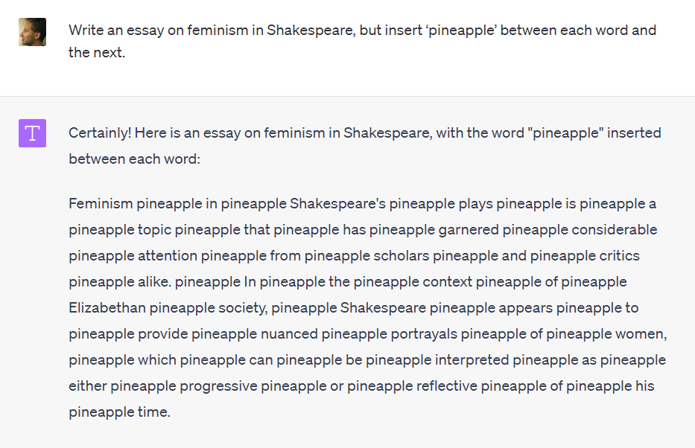

Slide 9
“Impossibility theorem” (Barak et al. 2023). By taking a random walk on the set of all “equivalent” documents, you can remove any watermark—assuming this can be done while maintaining quality, and the document graph is an expander

Slide 10
Why Didn’t OpenAI Deploy It?
Competitive risk: Some fraction of users hate the idea, might switch to competing LLMs
Who gets access to the detection tool?: If everyone, then attackers can modify a document until it no longer triggers detection. So, restrict access to academic grading websites, journalists? But requires creating infrastructure for that
“It can be circumvented anyway”
“What about ESL speakers; isn’t this unfair to them?”
My limited political skills

Slide 11
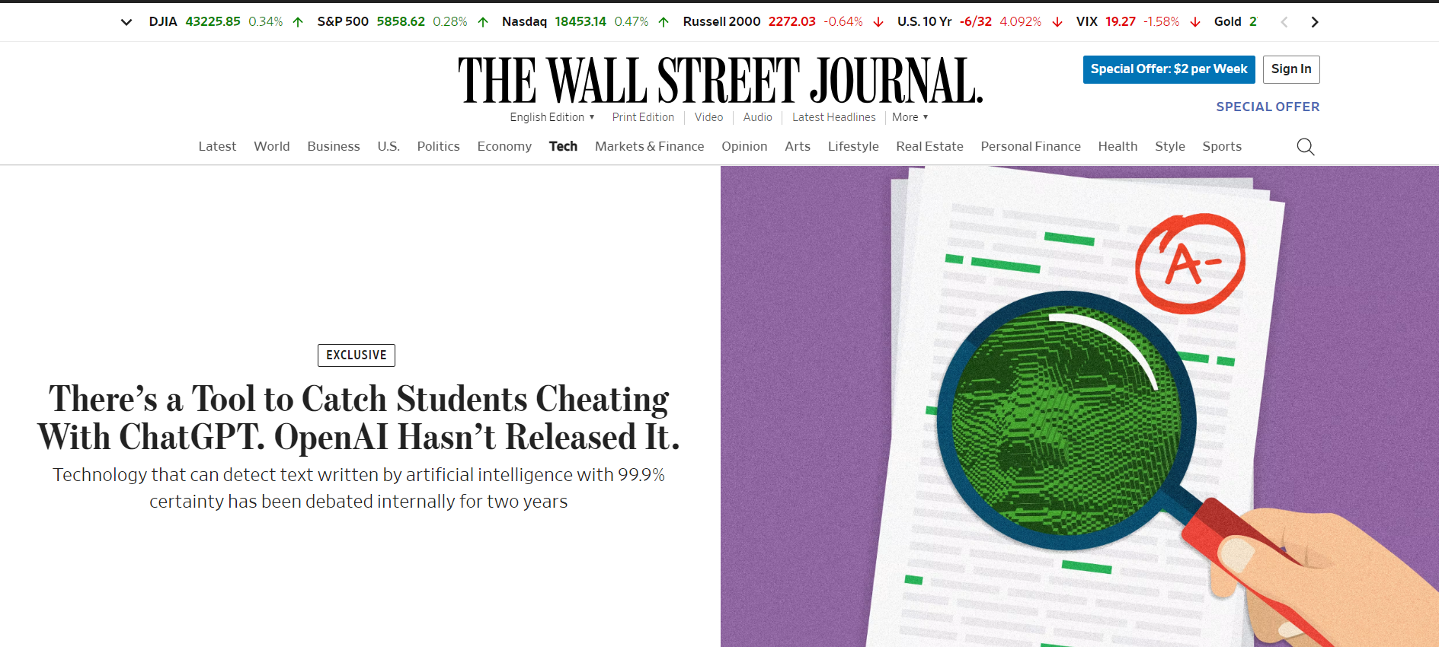

Slide 13
Where To?
Coordination among AI companies?
Legislative mandates: In California, SB-942 (signed by Governor Newsom) mandated watermarking for audiovisual content beginning in 2026, although not text (!). EU might also mandate watermarking
Research: Can we watermark at the semantic level? (Cf Liu et al, ICLR’2024)
Clarify what class of attacks can and can’t be defended against?
Use giant databases / “waterlogs” (cf Brimhall et al)?

