Slide 1
The Future of Quantum Supremacy Experiments
Scott Aaronson (University of Texas, Austin)
University of Wisconsin, Madison, April 4, 2025

Slide 2
Quantum Computing
n entangled particles
⇒ 2^{n} complex numbers to specify
Not just magic exponential parallelism—we only see a single sample on measurement!

Slide 3
What Will QCs Be Good For?
→ Simulating quantum physics and chemistry
→ Breaking current public-key encryption
→ We’ll have to get lucky for most other applications
(You’ve been systemically lied to about this)
→ But no matter! The #1 application: disproving all the people who say it can never work!

Slide 4
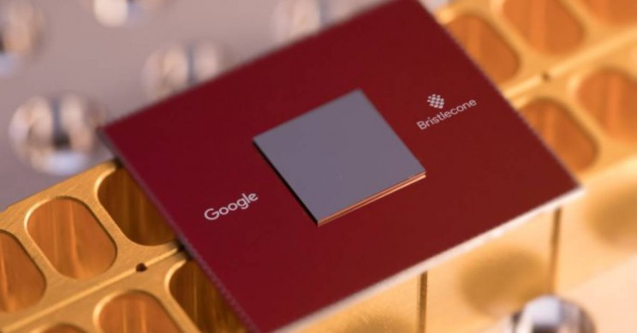
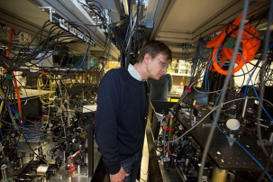
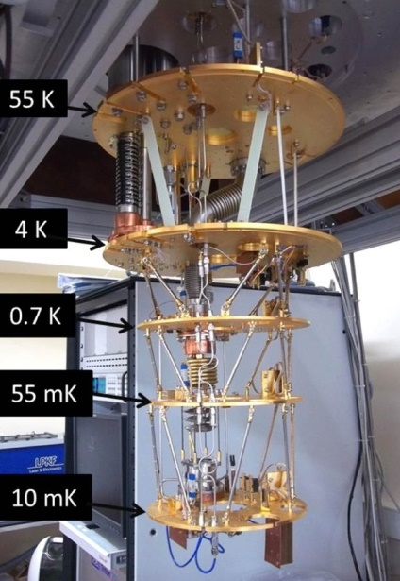
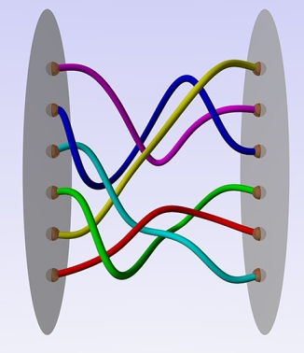
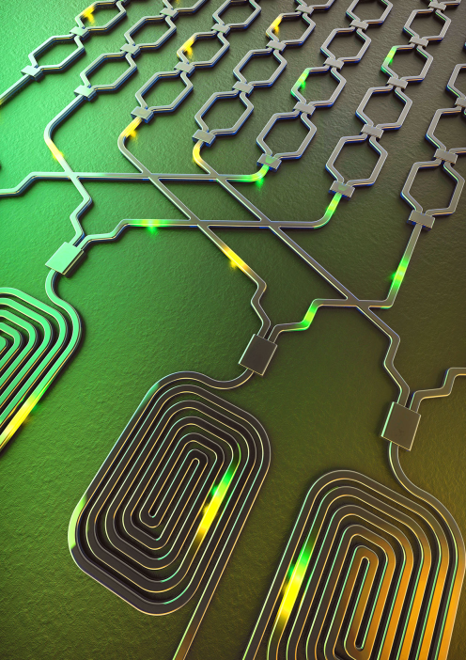
How to Build a QC…
Trapped Ions (Quantinuum, IonQ…)
Cold Atoms (QuEra, Atom…)
Superconducting Qubits (Google, IBM, …)
Photonics (PsiQuantum…)
Nonabelian Anyons (Microsoft…)

Slide 5
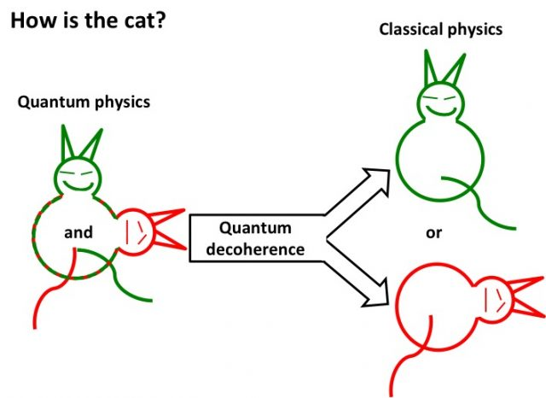
Why Is Building a QC So Damn Hard?
Decoherence: Unwanted interaction between the QC and its environment, prematurely “measuring” the QC
The more operations and qubits, the worse things get
In most QC researchers’ view, quantum fault-tolerance (discovered in the mid-1990s) provides the ultimate theoretical solution to decoherence
But fault-tolerance itself will require very precise physical control over the qubits—of a sort experimentalists seem unlikely to achieve for years (though they’ve made great strides)

Slide 6
What Is Quantum Computational Supremacy?
Preskill 2012
The use of a quantum computer to solve some well-defined problem much faster than any available classical computer running any known algorithm
Problem doesn’t need to be useful, but does need a hardware-independent mathematical definition
Need: an actual observed speedup, and a theoretical asymptotic speedup, and a causal connection between the two

Slide 7
The Random Circuit Proposal
Challenge the QC by sending it a randomly generated quantum circuit C on n qubits
Ask the QC to send back (quickly!) samples s₁,…,s_{k} from D_{C}, the distribution over n-bit strings obtained by applying C to 0…0
Then, using classical brute force, check if
$$\sum_{i=1}^{k}{{\left|\left\langle s_{i}\right|C\left|0⋯0\right\rangle \right|}^{2}}≥\frac{bk}{2^{n}}$$
Google’s “Linear Cross-Entropy Benchmark”
for some constant b∈(1,2)

Slide 8
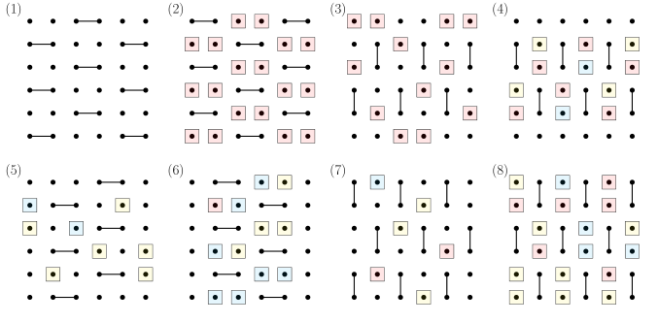
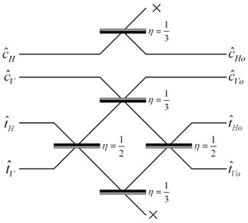
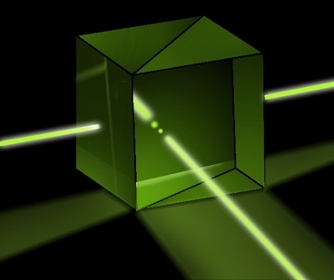
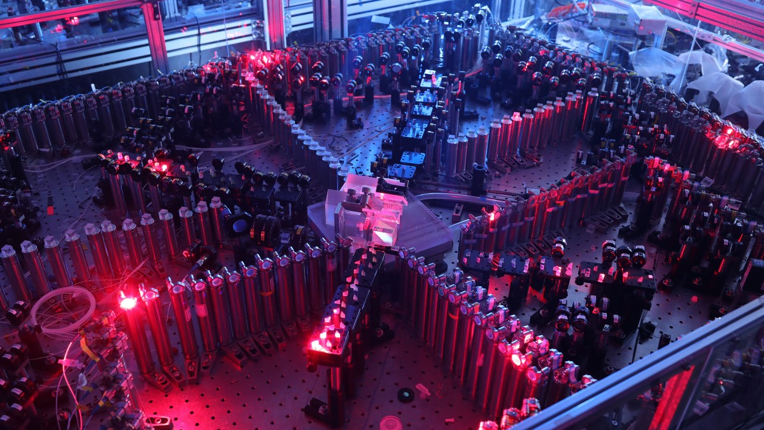
Quantum Supremacy Experiments Now
Random Circuit Sampling 53-qubit experiment by Google team 2019; USTC team 2020; new 103-qubit experiment on Google’s Willow chip, December 2024
BosonSampling A.-Arkhipov 2011, ~100-photon experiments by USTC team 2020 and Xanadu 2022; cold atom experiment by Young et al, Harvard, 2023

Slide 9
What’s Wrong With the Current Supremacy Experiments?
Lack of error-correction prevents scaling: Obvious.
Spoofing attacks:
Pan-Chen-Zhang 2021: Tensor network contraction
Gao-Kalinowski-Chou-Lukin-Barak-Choi 2021: Gets 1/exp(depth) advantage on Linear Cross Entropy Benchmark (XEB)
Most fundamental (in my view): Exponential time needed for classical verification!! (E.g. via Linear XEB)

Slide 10
Field Guide to Big Quantum Speedups
Doable On Current Devices
QAOA
Efficiently
Verifiable
Quantum machine learning
?
Shor
Mahadev
BosonSampling
Yamakawa-Zhandry
Random Circuit Sampling
Physics simulations
In-Principle Quantum Advantage

Slide 11
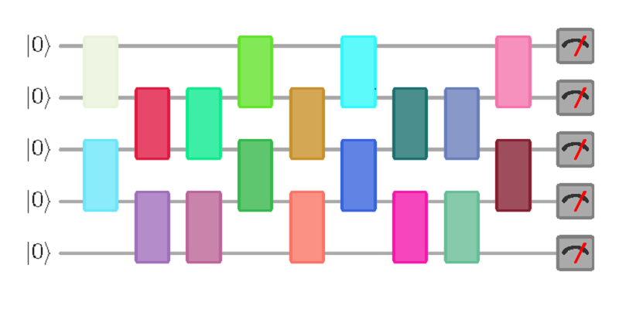
Question I Posed A Few Years Ago
Call a quantum circuit C “peaked” if |⟨x|C|0^{n}⟩|²≥0.1 for some basis state |x⟩.
(More generally: if C|0^{n}⟩ has any nonrandom features easy to notice on measurement)
Suppose I pick a random peaked circuit with (say) n qubits and m=n² gates. Can any classical algorithm tell it apart from a completely random circuit?
|0⟩
|0⟩
vs.
U
U⁻¹
|0⟩
(obfuscated)

Slide 12
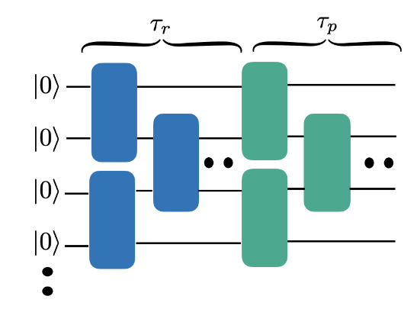
Numerical Investigation SA + Yuxuan Zhang, arXiv:2404.14493
Since the original question is too expensive to study, we instead ask: Given an n-qubit quantum circuit C with τ_{r} random layers, how many more layers τ_{p} of our choice must we append to it, to get an overall peaked circuit?

Slide 13
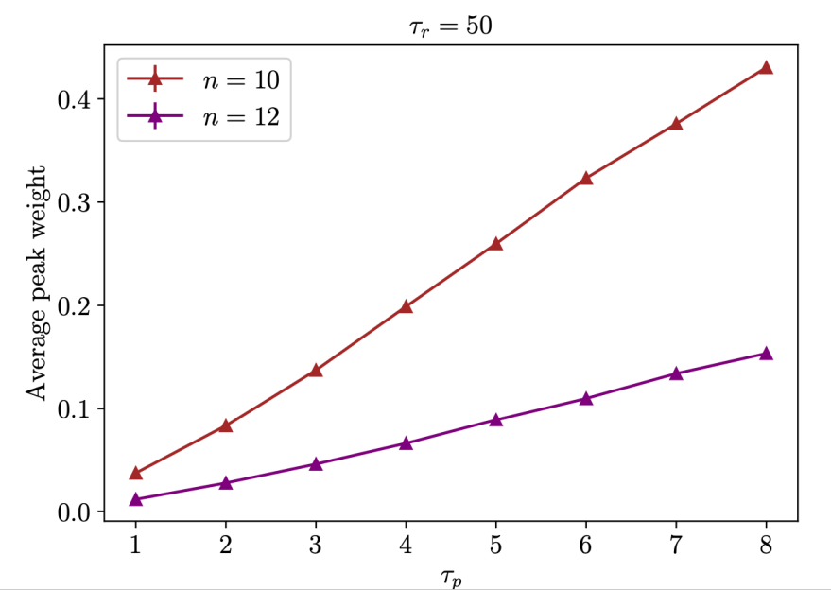
Data on Peakedness: It’s There!

Slide 14
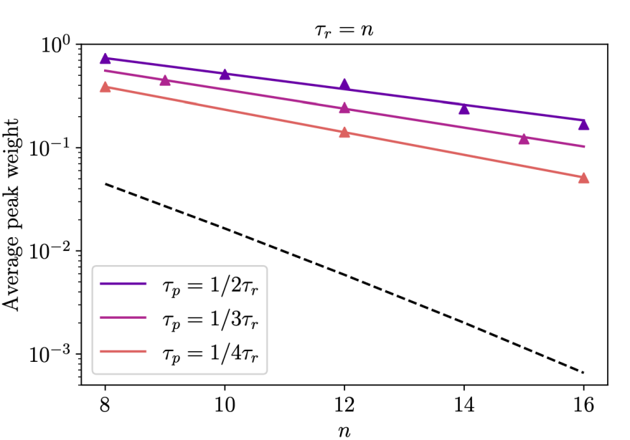
Output distributions look random except for the peak…

Slide 15
Certified Randomness from Quantum Supremacy (A. 2018, A.-Hung 2023)
SEED
CHALLENGES
Insight: If a device quickly, repeatedly passes the Linear XEB test, then even assuming it’s a QC, under a suitable hardness assumption, its outputs must contain lots of entropy; they can’t be secretly deterministic

Slide 16
Means that current quantum supremacy experiments could have an actual application: generating cryptographically certified random bits!
Generating random bits using QM is trivial. But how do you prove the randomness of the bits to a faraway skeptic, who doesn’t trust your hardware?
Why do we want this? Lotteries, zero-knowledge protocols, proof-of-stake cryptocurrencies like Ethereum…
Sketch of protocol: Skeptic generates pseudorandom challenge circuits C₁,C₂,…, sends them to QC, gets back outputs, calculates their LXEB, and if the test passes, feeds the outputs into a randomness extractor
Assumption: The verifier starts with a small amount of “seed” randomness

Slide 17
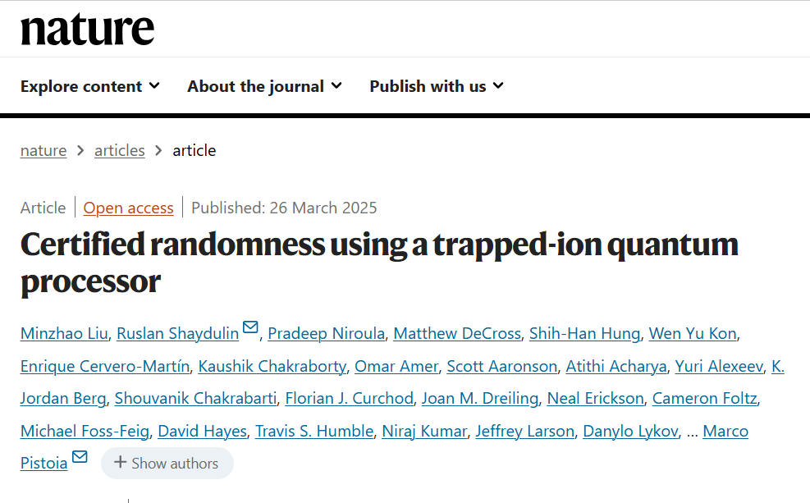
Experimental Demonstration! JP Morgan Chase and Quantinuum, March 2025
Used 56-qubit trapped ion device. Outputs verified using the Summit and Frontier supercomputers. Generated ~70,000 certifiably random bits over 1 day
Key Limitation: While spoofing the randomness seems to require giant supercomputers, we can’t make spoofing completely infeasible, or else verifying the outputs would also be! Brings us back to the main drawback of sampling-based quantum supremacy itself…

Slide 18
Summary
Multiple experimental groups have now achieved huge apparent quantum speedups, for contrived sampling tasks with 50-100 qubits … but checking the answers with a classical computer also seems exponentially hard!
Scalable fault-tolerant QCs (capable of Shor’s algorithm, verification protocols, etc.) should solve this problem, but I’m too impatient to wait for that
Key Challenge: Efficiently verifiable quantum supremacy with a near-term device (e.g. using peaked circuits?)
A solution to this challenge could have immediate application to generating certifiably random bits!

